Slide 1
55-604708: Project(Technical Computing)
The Project Specification, Ethics forms and Research

Slide 2
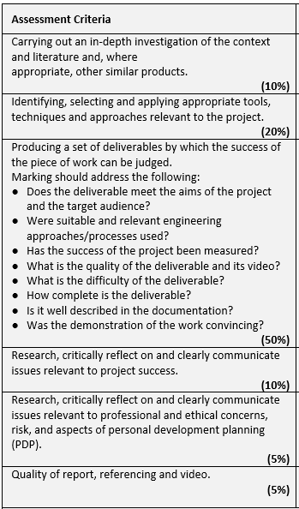
Project Marking Scheme
In summary
30% research
50% doing
20% evaluating

Slide 3
The Project Specification
Serves three main purposes
helps YOU to clarify what your project is about
helps us & you (at the end) to judge the success of the project
how well did you meet the aims of the project?
were there aspects of the project that went less well? why?
helps you be sure you are undertaking ethical work

Slide 4
Project Specification Pro-forma
Is available on the Bb site.
5 main sections
Elaboration
what's the project about? why is it interesting? why is it relevant/appropriate for your course?
Project Aims
what do you hope to achieve/get out of the project?
where do you want to be by the end?
it's not how you will do it or the steps you will take to achieve it – these would be objectives
Project Deliverable(s)
what is the deliverable going to be?
Tasks/Action Plan
how are you going to hit those aims -the objectives?
what are you going to do?
some sense of how much time these objectives might take..
Codes of Conduct
BCS
publication of work
GDPR

Slide 5
Ethics Forms
You are required to complete an ethics form about your project.
As most of your will be carrying out some sort of user testing you will need to complete a UREC2 (available on BB)
Included in this is your testing plan with the first iteration of any forms, surveys or questionnaires you plan to use.
Your supervisor will be able to help you with this.
Submission of the ethics form, supporting materials and the project specification is in the Assessment folder on BB .

Slide 6
Suggestion for writing the spec
You could try working backwards...
start with tasks for your action plan (might be more obvious...)
Think of structure and activities laid out in the previous session
background review, development, testing, etc
how do these relate to your project idea?
what are key milestone dates? These should appear on spec
pose question: why are you doing them? what do you hope to achieve/gain by doing them?... helps to identify aims.
When you've got an idea of what you'll be doing and why, writing the description should be more straightforward...
Use a tool like Freemind (a mind-mapping tool)
http://www.techradar.com/reviews/freemind

Slide 7
Project Specification Additions
BCS Code of Conduct - you must pass the on-line test with a mark of 70% or more and sign to say you have done this. See separate section on Bb.
student signature
Publication of Work - sign to say you have read the guidance on Bb (in Module Documents)
student signature
GDPR (general data protection regulation)- sign to say you will use the Participant Information Sheet as a basis for all survey, questionnaire and participant testing material
student signature
Ethics Form and supporting materials
Student signature
Supervisor signature
5 signature places in total - electronic versions are OK.

Slide 8
Timescale
Nominally, 40 credit module suggests 400 (real) hours of effort.
It represents 1/3rd of your final year modules: so around 33% of your time: so in a typical working week you should be looking at spending 1½ to 2 days on the project
You and I both know that will be difficult to achieve, but you can try.

Slide 9
Moderation
Your supervisor will know what they are doing, but to play safe we'll get a second person to look at your spec
which is one of the reasons why you have to submit to Blackboard early in your project
They will be looking for:
appropriateness/relevance to course
feasibility (can it be done in time available)
clear focus
good plan
scale/complexity/ambitious...
could you get a first on it?
can you pass?

Slide 10
What next?
How to use the library systems for research demonstration
Try to decide on a project and find a project tutor
If you still haven't got a project idea or tutor then come to the Project (Technical Computing) drop-ins. Format and dates to follow on Bb.
Tomorrow:
10am Lecture 3: Ethics, Marking, Examples

Slide 11
Research
Simon Quinn (s.c.quinn@shu.ac.uk), Librarian

